Slide 1
End-to-end learning for vEHILCE Trajectory Prediction
TEAM 4
Hoonhee Cho
Kunho Kim
Hyojin Sim
Saeyoon Oh
Notes:
Hello My name is hoonhee cho.
We're Team4, and the topic of the presentation is End-to-end learning for Vehicle Trajectory Prediction.

Slide 2
01 introduction
02 METHODOLOGY
03 RESULTS ANALYSIS
04 CONCLUSIONS
INDEX
Notes:
This is our Contents

Slide 3
01. introduction

Slide 4
Research about Trajectory
Self driving cars have received lots of attention for several years. And,
Trajectory Prediction can be used as a very great tool to monitor the autonomous driving system.
The task aims to predict spatial coordinate of various road-agents such as cars, pedestrians, animals, etc.
Therefore, this means if the prediction can be done in real-time, the technique can help to prevent (or warn) upcoming accident.
Therefore through the research, we tend to build a novel model for ourselves to tackle this subject.
Notes:
As you know, recently Self driving cars have received lots of attention.
So, Trajectory Prediction can be used as a very great tool to monitor the autonomous driving system. Because, the trajectory can help to prevent upcoming accident.

Slide 5
Basic model
MTP(Multimodal Trajectory Predictions) supposed in 2019 ICRA.
Encoding the surrounding situation and the agent that want to predict, such as HD map, lane direction, and location of the surrounding actors, in the form of raster images.
Create future paths with the input of the generated Lester image and the current state of the agent (speed, acceleration, and rate of change in direction).
Notes:
Among the papers related to Trajectory, we found MTP using deep learning for the first time.

Slide 6
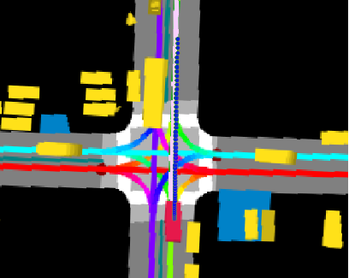
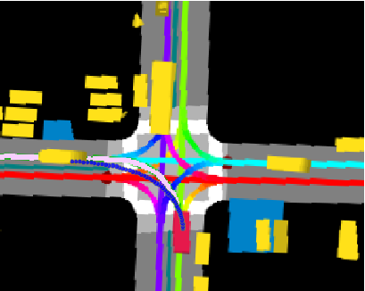
Dataset
For input data, We used nuScenes dataset. (https://www.nuscenes.org/) Traffic agent and surrounding road environment are encoded as raster images like below:
[Fig 1] Raster image encoded from road-agent environment
Notes:
They used Nuscences dataset encoded in raster image on actual observed roads.

Slide 7
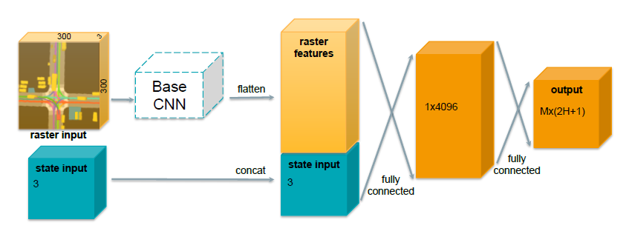
Basic model
MTP has a simple CNN network structure consisting of Backbone DCN and two FC layers that extract features from images.
[Fig 2] Network architecture of MTP
Notes:
Their model architecture is very simple. Put Raster image on CNN to extract feature, and connect it with states such as speed and acceleration of the agent. Then, make an output using MLP.

Slide 8
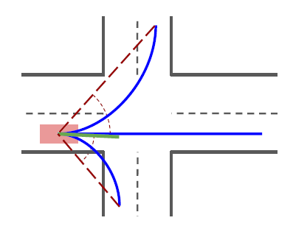
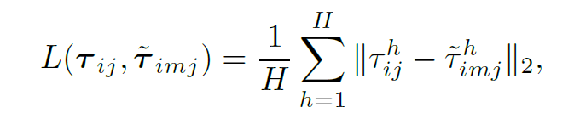
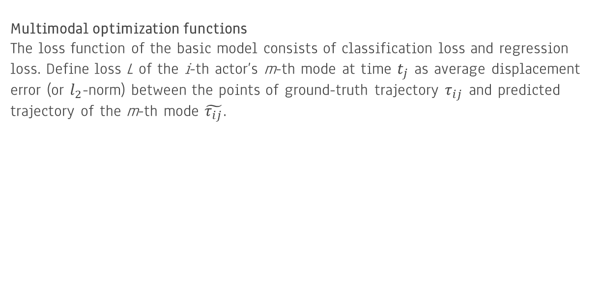
Evaluation of Basic model
Multimodal optimization functions
The loss function of the basic model consists of classification loss and regression loss. Define loss L of the i-th actor’s m-th mode at time $t_{j}$ as average displacement error (or $l_{2}$-norm) between the points of ground-truth trajectory $τ_{ij}$ and predicted trajectory of the m-th mode $\tilde{τ_{ij}}$.
[Fig 3] loss of MTP
[Fig 4] Mode selection methods
Notes:
They used the L2 norm as the Loss function and allowed one agent to print multiple path.

Slide 9
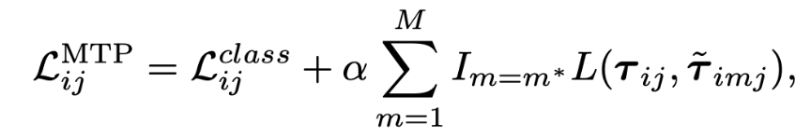
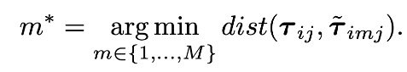
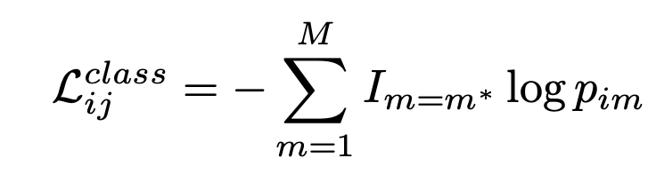
Evaluation of Basic model - continued
Loss of model
While previous loss refers to a loss of a trajectory, the total loss of model is defined as follows.
Note that this is a bit strange since we only look at the best mode.
The problem of loss can be found in the result.
Notes:
Classification loss was also used using the most likely path of the output path.

Slide 10
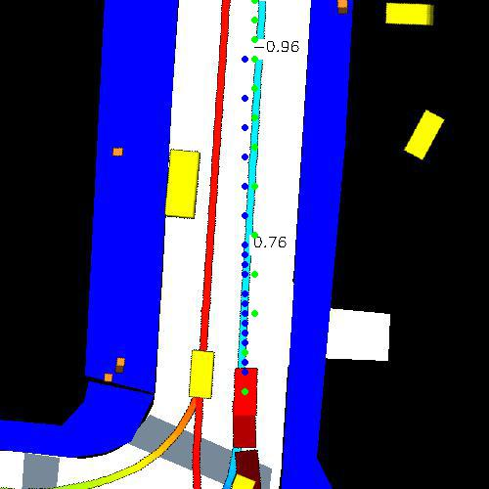
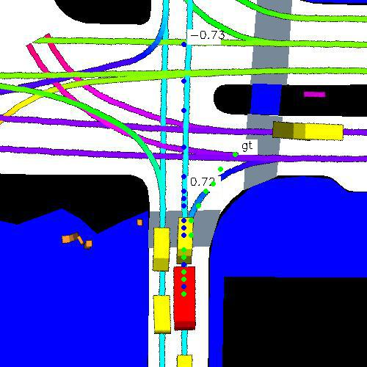
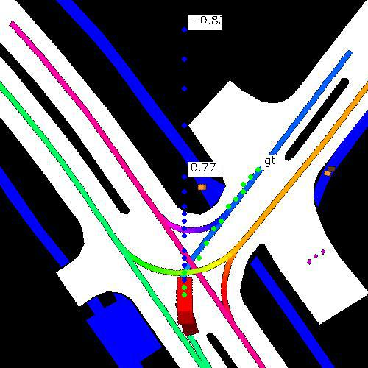
Baseline results
Green line: Ground Truth
Blue line: Predicted path
Numbers: probability
Note that the paths are somewhat not plausible & it tends to generate straight lines with high prob.
Part of this problem is due to the Nuscenes datset, loss
Notes:
In the beginning of the project, we implemented MTP and found some problems. They invaded non-drive area, No rotation at all.

Slide 11
Some more results & observations
Hyperparameter matters a lot (Sometimes no left, right turns.)
Problematic Loss & Model
1. Loss only targets best modes
2. Model does not take context into account
Notes:
So we concluded that in the end only one of the various pathways is meaningful, and that it also does not take into account the context of the image at all.

Slide 12
02. METHODOLOGY

Slide 13
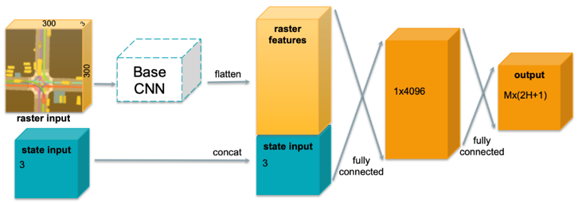
Problem of base network
01
Multi-agent system
● Before Prof.’s Feedback,
Only one agent is set to an input of our network.
● Problem
Cannot consider the “interaction”
between agents
Notes:
We accepted the professor's feedback to fix these problems.

Slide 14
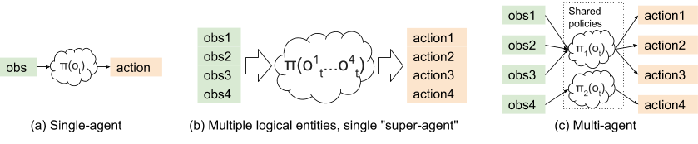
Problem of base model
01
Multi-agent system
● Before Prof.’s Feedback,
Only one agent is set to an input of our network.
● Problem
Cannot consider the “interaction”
between agents
● After Prof.’s Feedback,
Use multi-agent system, by utilizing all agents’ past path as inputs
Notes:
We changed to a model that outputs one path each for all the agents in the picture. So, use the history of path of other agents as input.

Slide 15
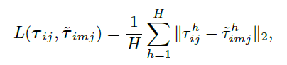
Problem of base model
02
Autoregressive model
● Before Prof.’s Feedback,
We are applying a single m for the loss function of the model.
<Previous Loss Function>
● Problem
As it has only one ground-truth at each step, the loss function is less meaningful and straightforward.
Notes:
We don't think the current Loss is enough,

Slide 16
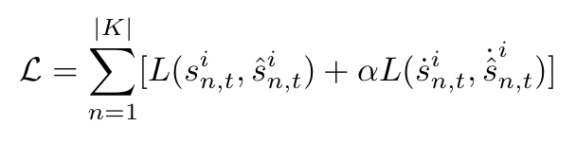
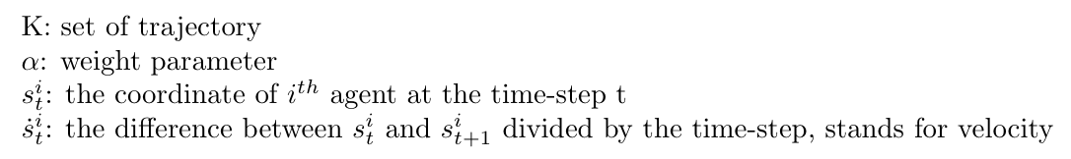
Problem of base model
02
Autoregressive model
● Before Prof.’s Feedback,
We are applying a single m for the loss function of the model.
<Current Loss Function>
● Problem
As it has only one ground-truth at each step, the loss function is less meaningful and straightforward.
● After Prof.’s Feedback,
Use LSTM, by taking history values as inputs so to manage multi-agents path outputs at every step.
Notes:
We got the loss for all the agents in the image using LSTM, and we used the loss using the difference of displacement.

Slide 17
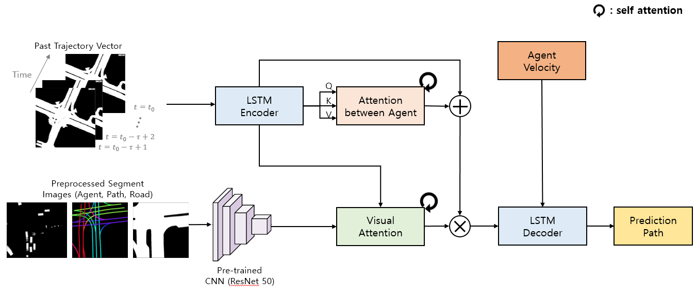
03
Proposed network
Context multi-agents trajectory path
Notes:
Finally, the model we propose is as follows. To solve the problem of not being able to read the existing context, we simply did not use the image of 3 channels. I separated the image sensitively and put it together into input.
In addition, past trajectories were used as input to use interaction and sequence information between agents.
The past vector comes out of the LSTM Encoder, and is used to obtain agent-to-agent attention. The image feature and Past trajectory attentions are obtained and finally entered the decoder.
Use the agent's Velocity as input every lstm to predict path.

Slide 18
03. RESULTS ANALYSIS

Slide 19
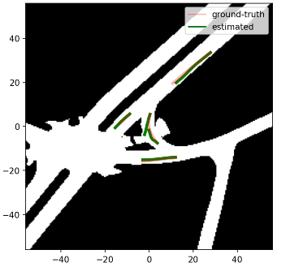
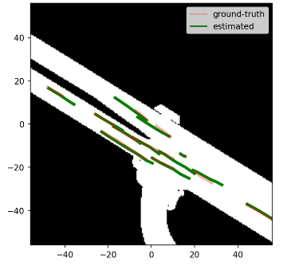
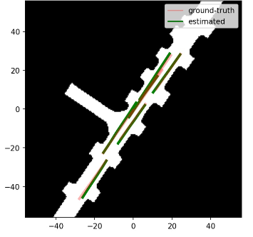
Analysis of results
Our model can predict multiple agents trajectory at the same time
Read the text of the image, so that it does not intrude on non-drive area.
<Our Model Prediction>
Notes:
The result is, as shown in the picture below,
Our model can predict multiple agents trajectory at the same timeRead the text of the image, so that it does not intrude on non-drive area.
Agents can also do some rotation.

Slide 20
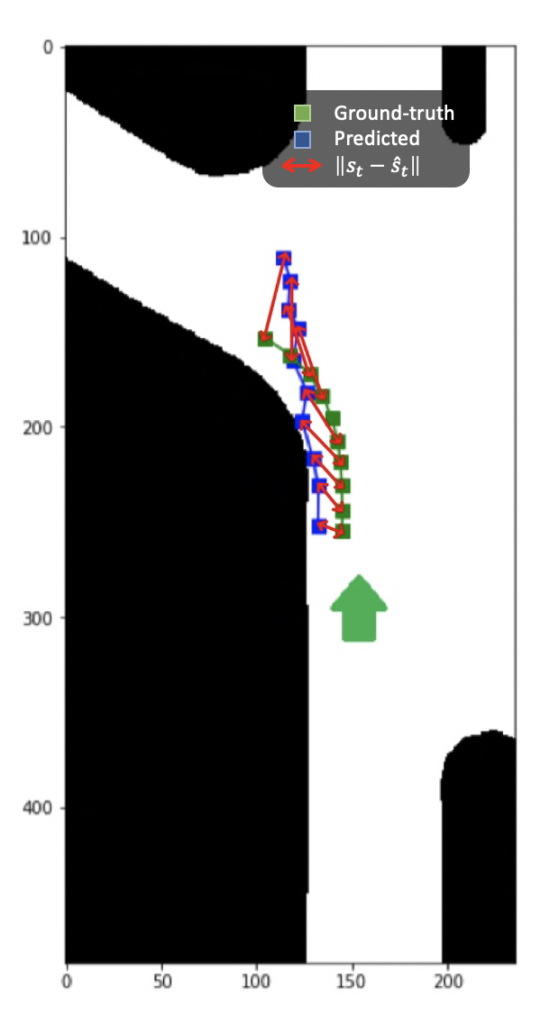
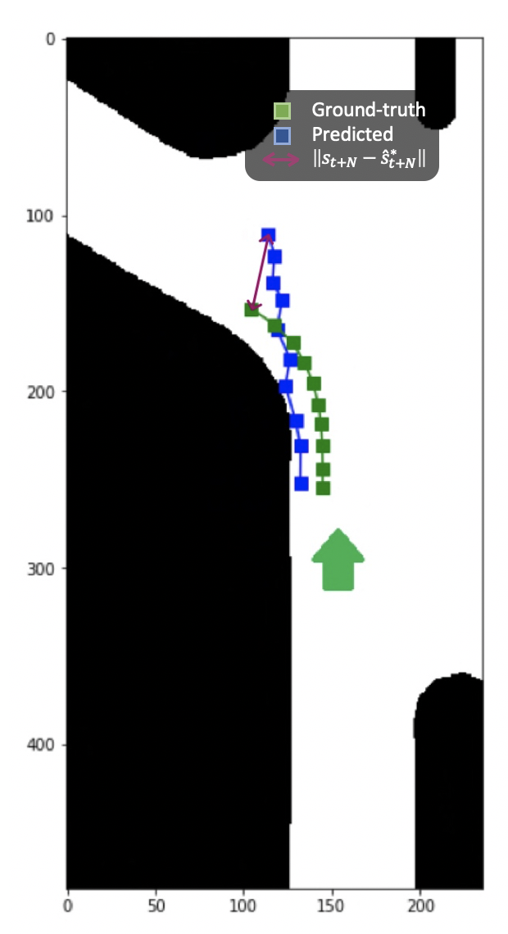
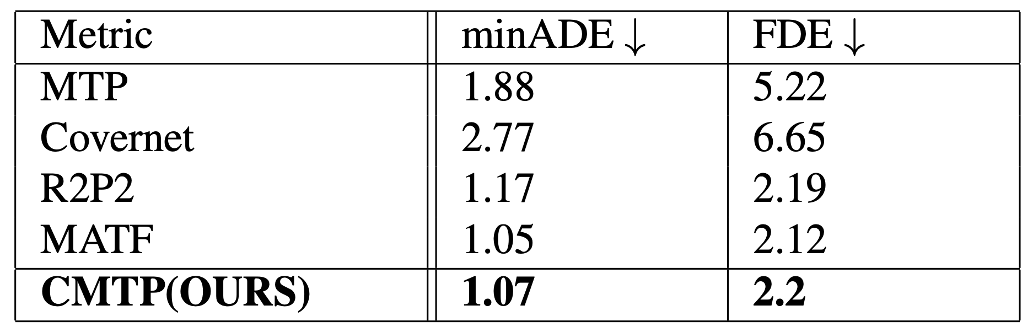
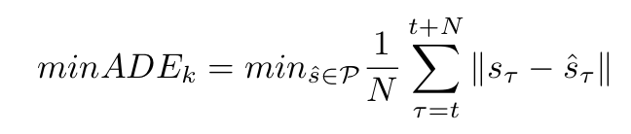
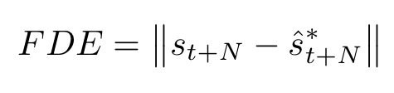
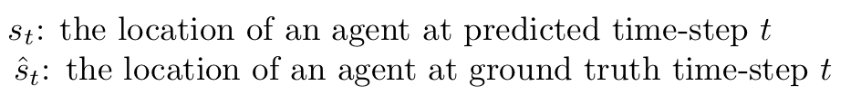
metric
The ADE and FDE are common metrics used in prior work on trajectory forecasting.
<minADE>
<FDE>
Notes:
To compare performance with other models, we used a metric called ADE and FDE.
You can see that it actually shows high performance.

Slide 21
04. Conclusion

Slide 22
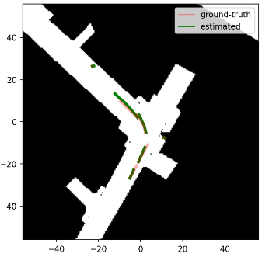
Analysis of results
<Original MTP Model Prediction>
Our model has been significantly improved performance compared to the base model, MTP.
There are three reasons for that:
1. Our model data input has only the necessary data. Therefore, it facilitates model learning.
2. While the existing MTP did not use sequenced data, we used past path using LSTM.
3. Performance was improved by using Attention, which gives weight only to the necessary parts of the entire PATH and IMAGE.
<Our Model Prediction>
Notes:
The reason why our model performs well is because only the semantic data is input.
And, the sequential data was used.
In addition, contexts can be read using the attention

Slide 23
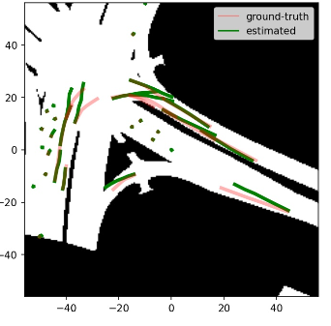
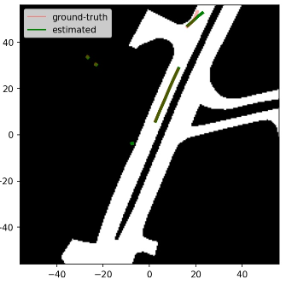
weakness
The part where the model is still weak is the rotational movement.
The model does not leave the road, but sometimes it goes straight when it has to turn.
We think the problem with these vulnerabilities because of the data.
Nuscences data set was collected using a real road.
Therefore, 95% of the agents in the data are data sets that go straight.
This biased dataset is a big problem.
<Our Model unsatisfactory Prediction>
Notes:
However, there are still some weaknesses. The fact that the model is not very good at spinning is because of the bias of the data. 95% of the nuscences dataset actually only go straight.

Slide 24
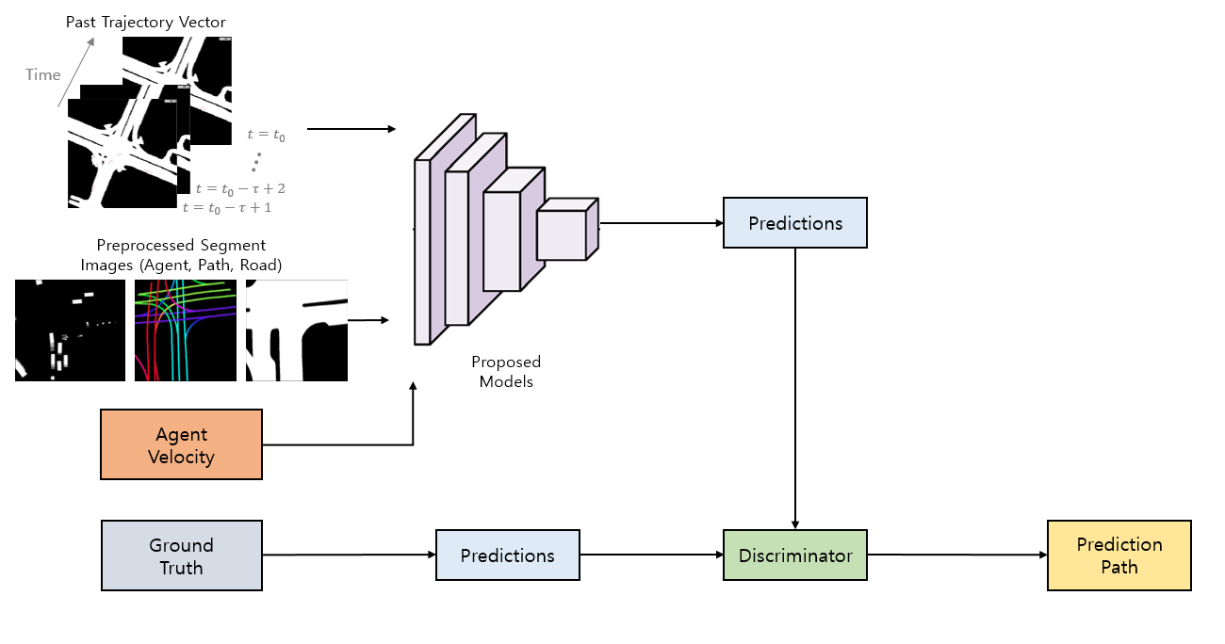
Post research
We will be able to improve the performance of the model by using discriminator.
Notes:
This part is planned to be studied later, and we plan to increase performance by comparing our prediction path with ground truth using the discriminator in the later.

